Slide 1


JAVA (Skill Based Lab)
MODULE 3: ARRAYS,STRINGS,VECTORS
Prof Indu Anoop

Slide 2
What’s in this Module
1.arrayS
1.1 1-D Array
1.2 2D ARRAy
1.3 PROGRAMS
01
2. STRINGS
2.1 STRING INTRO
2.2 STRING FUNCTIONS
2.3 STRING BUFFER
02
3. VECTORS
03

Slide 3
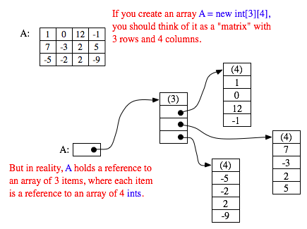
1. and 1.2 Arrays
One and Two Dimensional arrays,
Irregular arrays
dynamic arrays
Array List

Slide 4
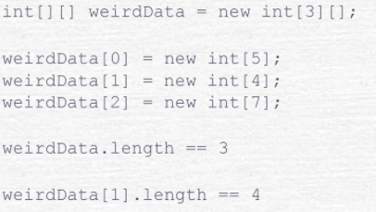
Arrays
One and Two Dimensional arrays,
Irregular arrays
dynamic arrays
Array List

Slide 5
Arrays
In Java, an array is an object. This object has a given type for the contained primitive types or objects (int, char, String, ...).
An array can be declared in several ways:
int [] array1=null;
int array2[] =null;
Arrays can also be instantiated in several ways:
array1 =new int[10]; //instantiate an array of 10 items that get default value (which is 0 for int)
array 1= new int[] {1,2,3,4,5,6,7,8,9,10}
Int[] array0={1,2,3,4,5,6,7,8,9,10}

Slide 6
Array Real Life Example
One-dimensional array profit[storeNum] has a very useful meaning: It is just the profit data for one particular store for the whole year.
Let's assume that the profit array has already been filled with data. This data can be processed in a lot of interesting ways. For example, the total profit for the company -- for the whole year from all its stores -- can be calculated by adding up all the entries in the array:
double[] profit =new double [26][12]; //profit[storeNum][monthNum] would be the //amount of profit earned in store number storeNum in month number monthNum
double totalProfit; // Company's total profit in 2006.
totalProfit = 0;
for (int store = 0; store < 25; store++)
{ for (int month = 0; month < 12; month++)
totalProfit += profit[store][month]; }

Slide 7
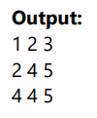
Exp7.1 : 2D Array Example
//Java Program to illustrate the use of multidimensional array
public class Test2DArray {
public static void main(String args[]) {
//declaring and initializing 2D array
int arr[][]={{1,2,3},{2,4,5},{4,4,5}};
//printing 2D array
for(int i=0;i<3;i++)
{
for(int j=0;j<3;j++)
{
System.out.print(arr[i][j]+" ");
}
System.out.println();
}
}
}

Slide 8
ArrayList
The limitation with array is that it has a fixed length so if it is full you cannot add any more elements to it, likewise if there are number of elements gets removed from it the memory consumption would be the same as it doesn’t shrink.
ArrayList can dynamically grow and shrink after addition and removal of elements

Slide 9
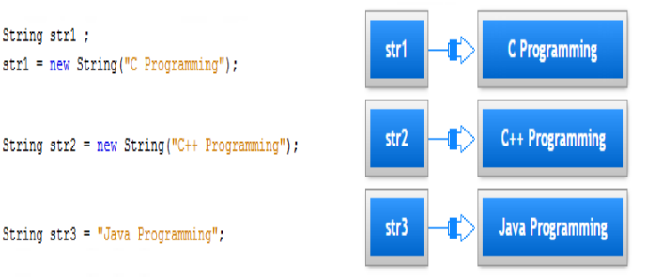
2.1 STRINGS: INTRODUCTION
The primitive data types are specified by the keywords int, double, etc. While these keywords start with a lowercase letter, the keyword String, which represents the string data type, starts with an uppercase letter. This is because of the fact that keyword String is the name of a predefined class. A Java string is an instantiated object of the String class. A String variable is simply a variable that stores a reference to an object of the class String. You declare a String variable in much the same way as you define a variable of one of the basic types. You can also three way to initialize it in the declaration. For example :
This declares the variable str1, str2 and str3 as type String and initializes it with a reference to a String object encapsulating the specified strin

Slide 10
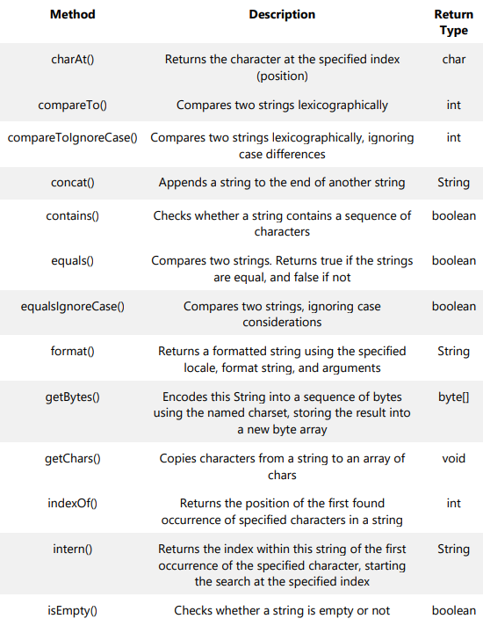
2.2 STRING FUNCTIONS

Slide 11
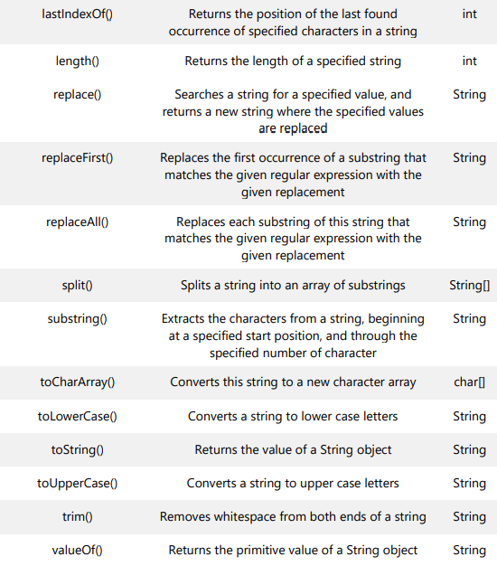
2.2 STRING FUNCTIONS

Slide 12
Exp6: Let’s learn String Functions

Slide 13
Major Difference Between String and StringBuffer
Once we create a string object we can’t perform any changes in the existing object. If we are trying to perform any changes with those changes a new object will be created. This non changeable nature is called immutability of the string object
Once we create a StringBuffer object we can perform any type of changes in the existing object. This changeable nature is called mutability of the StringBuffer object.

Slide 14
Comparison
 | String | String Buffer
Syntax | String s =new String(“indu”); | StringBuffer sb=new StringBuffer(“indu”)
Storage | Heap Area and SCP | Heap Area
Objects | Immutable objects | Mutable objects
Memory | If value of string is changed multiple times then more memory is allocated | Consumes less memory
Thread Safe | Not thread safe | All methods are synchronized and thus it is thread safe
Performance | Slow | Fast compared to String
Uses | If data is not frequently changing | If data is changing frequently
equals() method | String class overrides the equals() method of the Object class , so contents of two strings can be compared | StringBuffer doesnot override the equals() method of the Object class

Slide 15
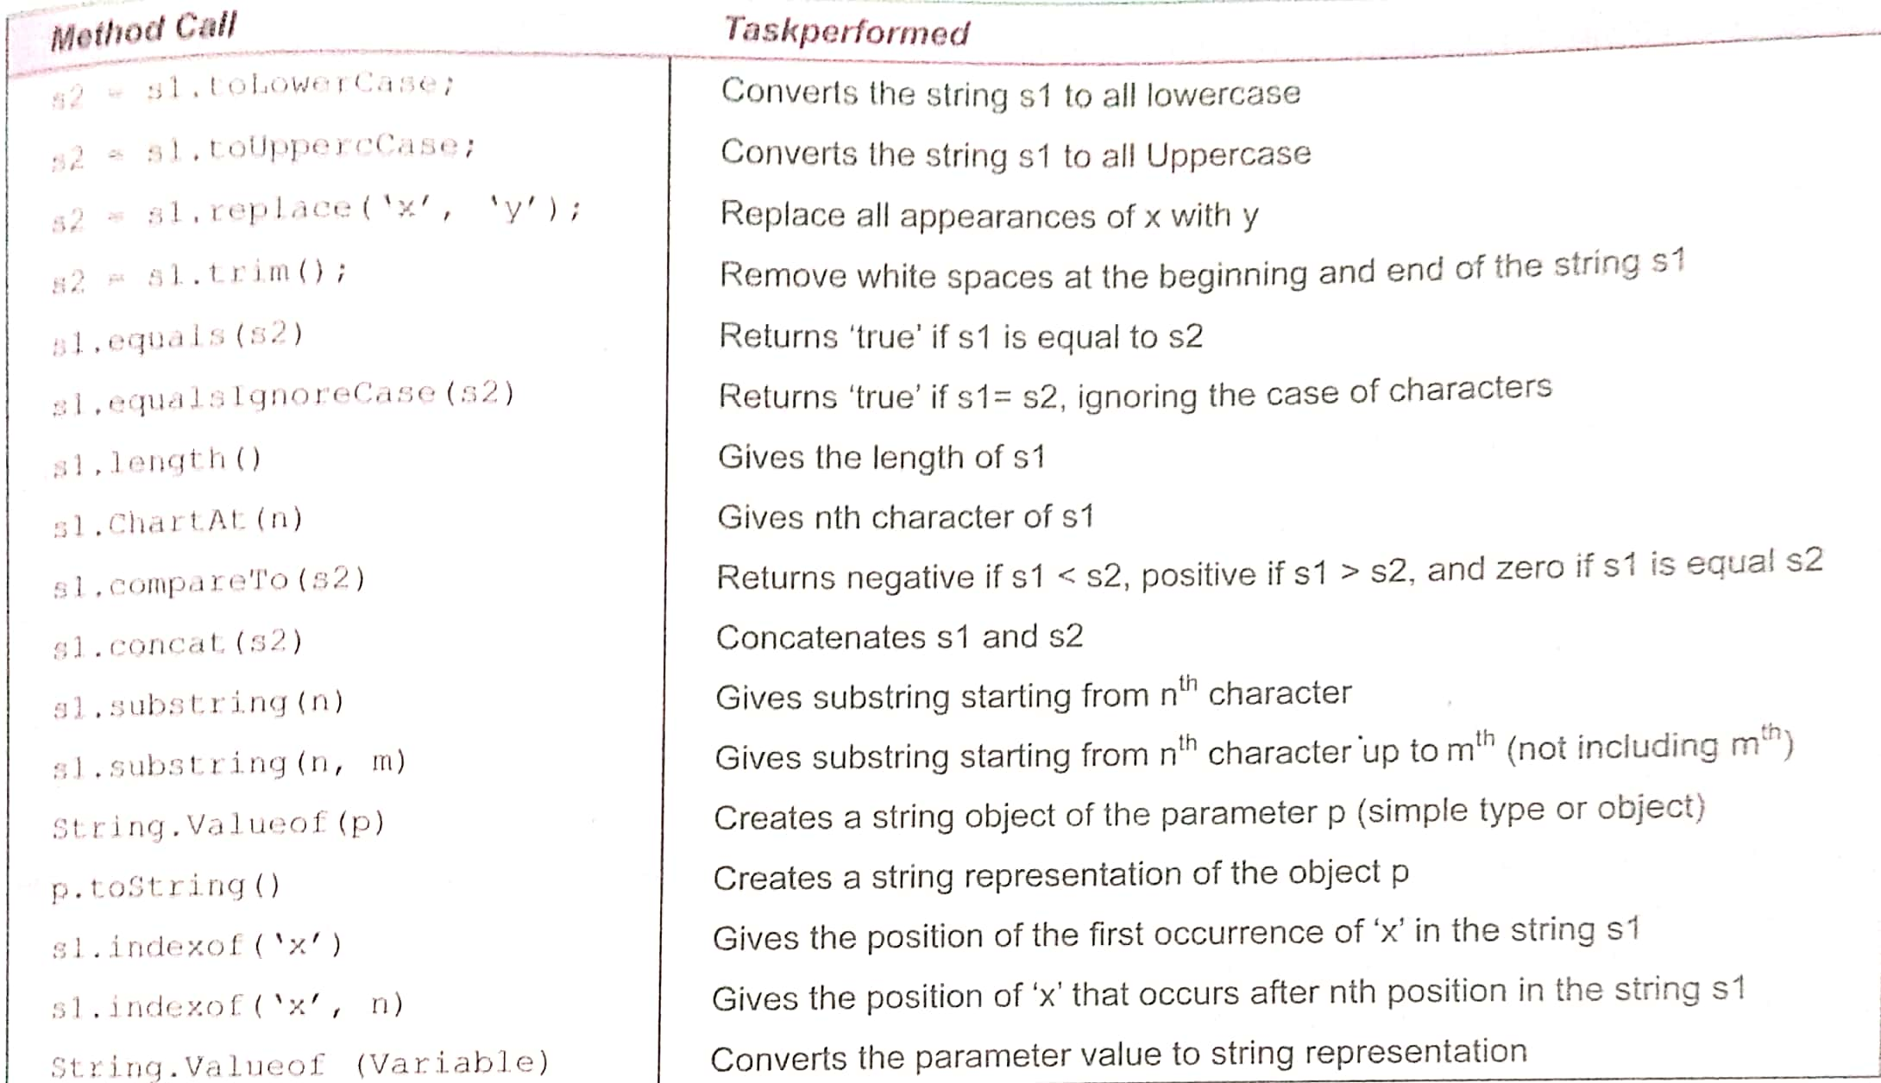
String Class and its Method calls

Slide 16
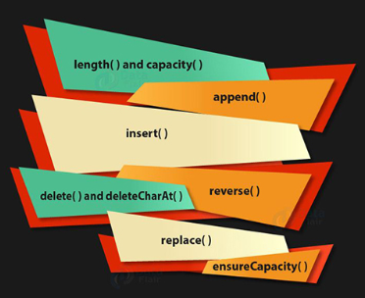
String Buffer

Slide 17
Exp6(cont’d): Let’s learn StringBuffer

Slide 18
Vector
The Vector class implements a growable array of objects. Like an array, it contains components that can be accessed using an integer index. However, the size of a Vector can grow or shrink as needed to accommodate adding and removing items after the Vector has been created.
It creates an empty Vector with the default initial capacity of 10. It means the Vector will be re-sized when the 11th elements needs to be inserted into the Vector. Note: By default vector doubles its size. i.e. In this case the Vector size would remain 10 till 10 insertions and once we try to insert the 11th element It would become 20 (double of default capacity 10).
Vector vec = new Vector();

Slide 19
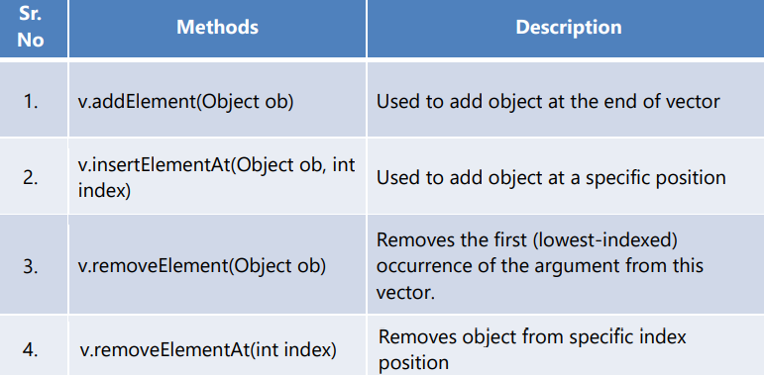
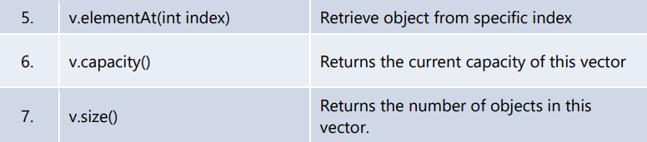
Vector Constructor and Methods
Vector( ) This constructor creates a default vector, which has an initial size of 10.
Vector(int size) This constructor accepts an argument that equals to the required size, and creates a vector whose initial capacity is specified by size.
Vector(int size, int incr) This constructor creates a vector whose initial capacity is specified by size and whose increment is specified by incr. The increment specifies the number of elements to allocate each time that a vector is resized upward.

Slide 20
When to use ArrayList and when to use vector?
It totally depends on the requirement. If there is a need to perform “thread-safe” operation the vector is your best bet as it ensures that only one thread access the collection at a time.
Performance: Synchronized operations consumes more time compared to non-synchronized ones so if there is no need for thread safe operation, ArrayList is a better choice as performance will be improved because of the concurrent processes.

Slide 21
Exp7 : Let’s learn Array , Array List and Vector

